Slide 1
Minimizing the Impact of Denial of Service Attacks on a Virtualized Cloud
Adel Abusitta, PhD Student (First year)
Supervisors: Pr. Martine Bellaiche and Pr. Michel Dagenais

Slide 2
Introduction
The industry push is increasingly shifting towards cloud-based services and applications. The main reason for that is because cloud user can reduce spending on technology infrastructure.

Slide 3
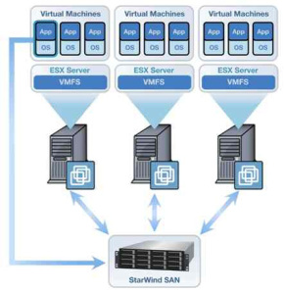
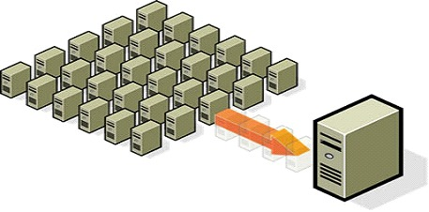
Introduction(cont.)
Virtualization has been proposed as an architecture to increase resource utilization, improving services and applications quality.

Slide 4
Problem statement
Virtualized systems are vulnerable to different type of attacks such as: denial-of-service (DoS) attacks. DoS attacks in virtualization occurs when one VM drains all the available physical resources, such that the hypervisor can’t support more VMs, and availability is imperiled.

Slide 5
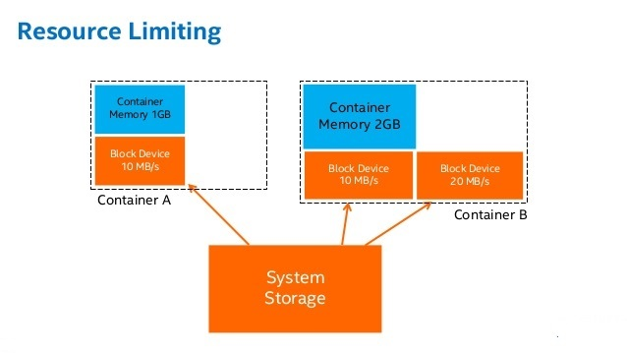
Problem statement (cont.)
The existing approaches to prevent DoS attacks are based on limiting resource allocation using simple configurations.

Slide 6
Problem statement (cont.)
However, these approaches are limited to understanding different behaviors of different applications.

Slide 7
Problem statement (cont.)
A recent survey about applications behavior shows that busy applications are not always under attack but may be overwhelmed by a large number of legitimate clients.

Slide 8
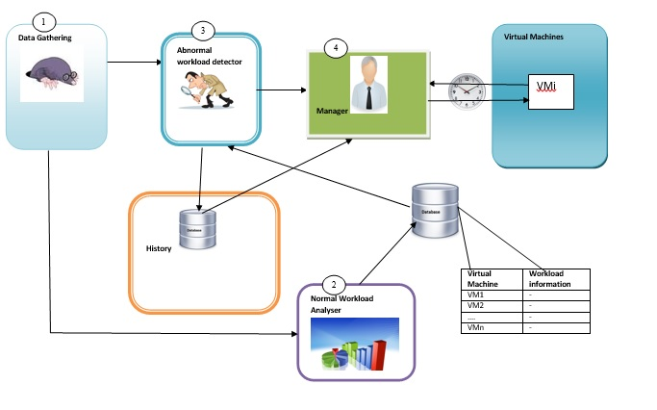
Proposed Architecture

Slide 9
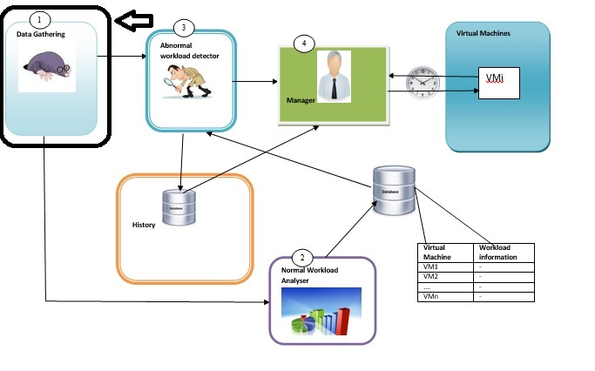
Proposed Architecture
Data gathering component: obtaining information about virtual machines(e.g, workload, activities and events)

Slide 10
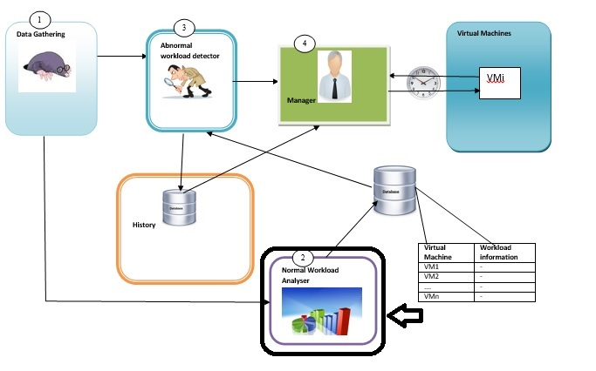
Proposed Architecture
Learning component: aims to understand the behavior of the VMs (e.g, normal workload under different frames of time)

Slide 11
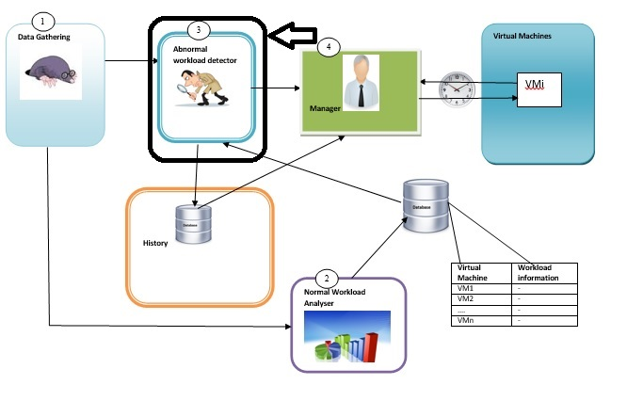
Proposed Architecture
Detection component: Having learned the behavior of the VMs from the second component, the detection component identifies the suspicious VMs.

Slide 12
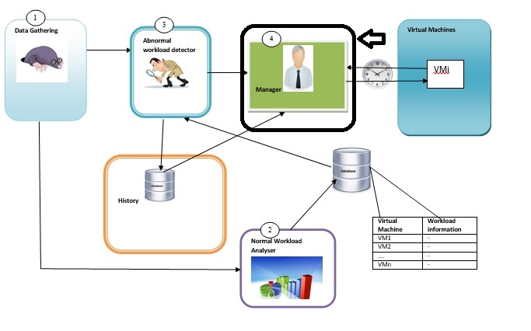
Proposed Architecture
Negotiation Component : aims to find the optimal decision making strategy that minimizes the resources wasting during DoS attack.

Slide 13
Proposed Architecture
The negotiation is made between the host and the suspicious VM. The host will decide whether to apply limitation directly on the VM shared resources or to give the suspicious VM some time hoping the abnormal behavior will be overcomed.

Slide 14
Proposed Architecture
The decision will be taken based on several factors, such as: the workload history of the suspicious VM and the available resources on the host.

Slide 15
Conclusion
A denial-of-service (DoS) attack in virtualization occurs when one or more VM drain all the available physical resources, such that the hypervisor can’t support more VMs, and availability is imperiled.
The existing approaches to prevent DoS attacks are based on limiting resource allocation using simple configurations.
These approaches are limited to understanding different behaviors of different applications.
Busy applications are not always under attack but may be overwhelmed by a large number of legitimate clients.
An optimal decision making strategies are required to minimize the resources wasting during DoS attack.

Slide 16
References
http://www.slideshare.net/LarryCover/baremetal-docker-containers-and-virtualization-the-growing-choices-for-cloud-applications
https://www.acunetix.com/blog/articles/slow-http-dos-attacks-mitigate-apache-http-server/
http://www.lookfordiagnosis.com/mesh_info.php?term=Behavior&lang=1
http://santaguidafinefoods.com/10292-2/http://santaguidafinefoods.com/10292-2/
http://www.hardwarezone.com.sg/feature-tech-trends08-virtualization/virtualizations-impact

Slide 17
Thank You…☺

